Slide 1
Peterson Ridge Station
3/12/24

Slide 2
Peterson Ridge Station
Project Description
This project establishes a new Metra commuter station on the Union Pacific North line located at Peterson Avenue and Ridge Avenue in Chicago. The scope of this project includes:
ADA compliant passenger boarding platforms
ADA compliant ramps
ADA compliant parking
44 commuter parking spaces
Sheltered passenger warming facilities
Visual information systems
Station signage and wayfinding
Landscaping

Slide 3
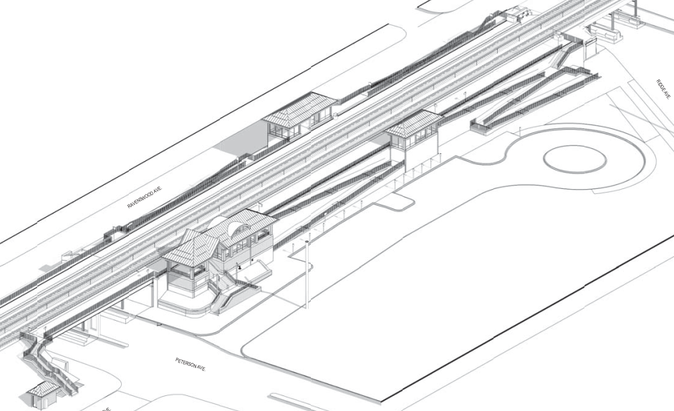
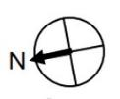
Peterson Ridge Station Rendering
STAIR & RAMP
WIND SHELTER
RIDGE AVE
STAIR & RAMP
STAIR & RAMP
WEST PLATFORM
BIKE RACKS
RAVENSWOOD AVE.
EAST PLATFORM
COMMUTER DROP OFF
ACCESSIBLE PARKING
RAMP
WARMING HOUSE
PETERSON AVE.

Slide 4
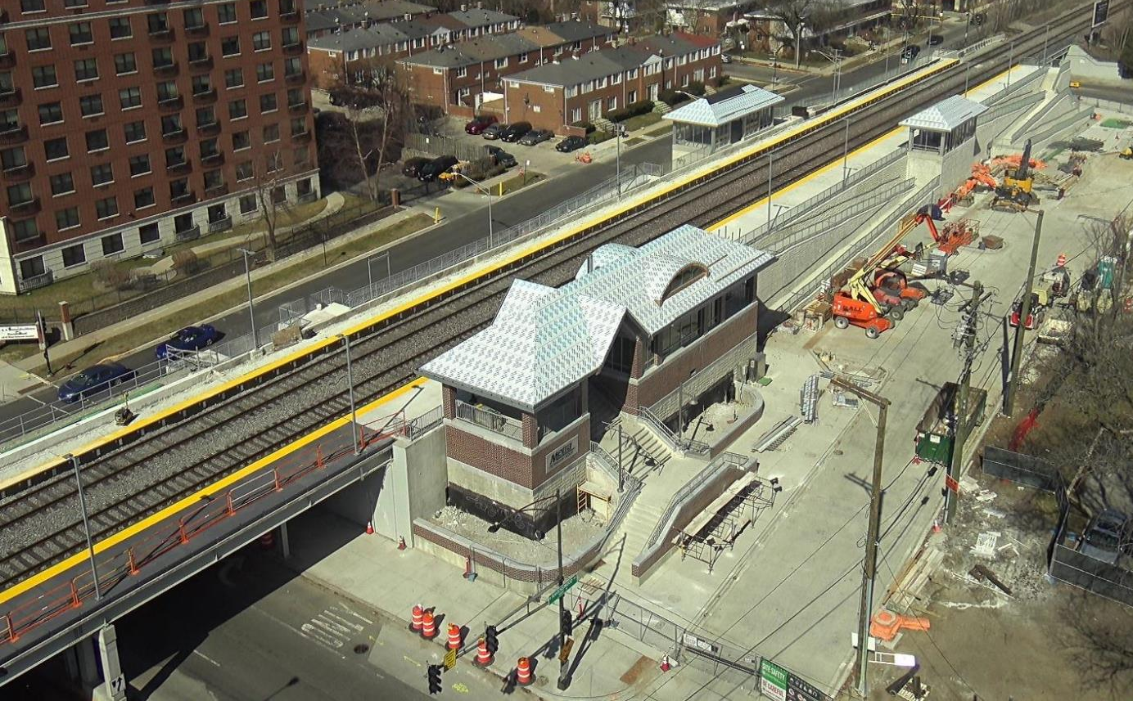
Peterson Ridge Station Progress Photo

Slide 5
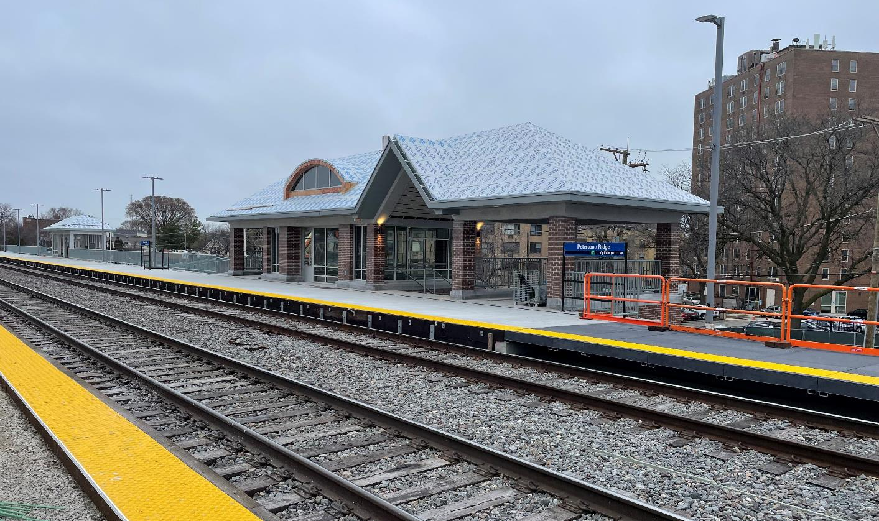
Peterson Ridge Station Progress Photo

Slide 6
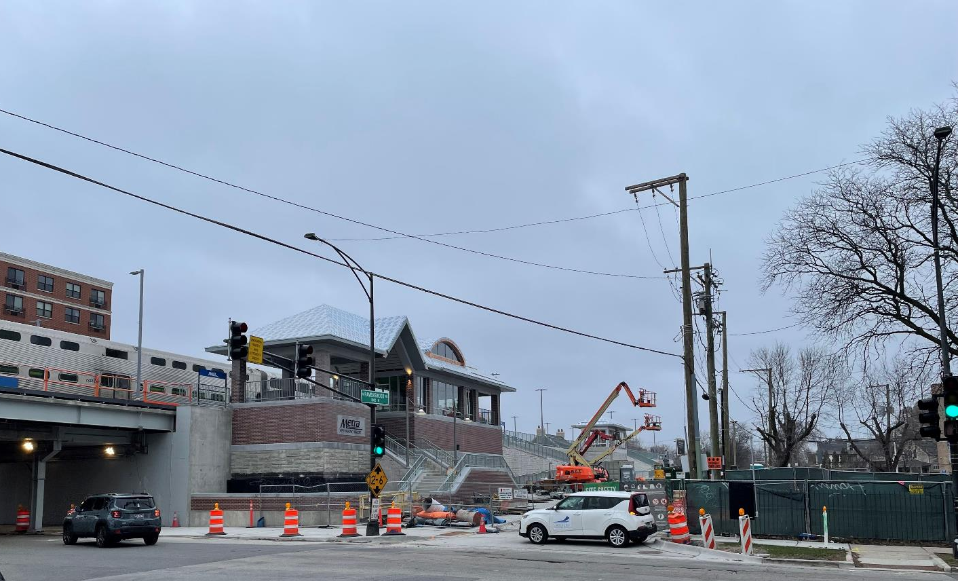
Peterson Ridge Station Progress Photo

Slide 7
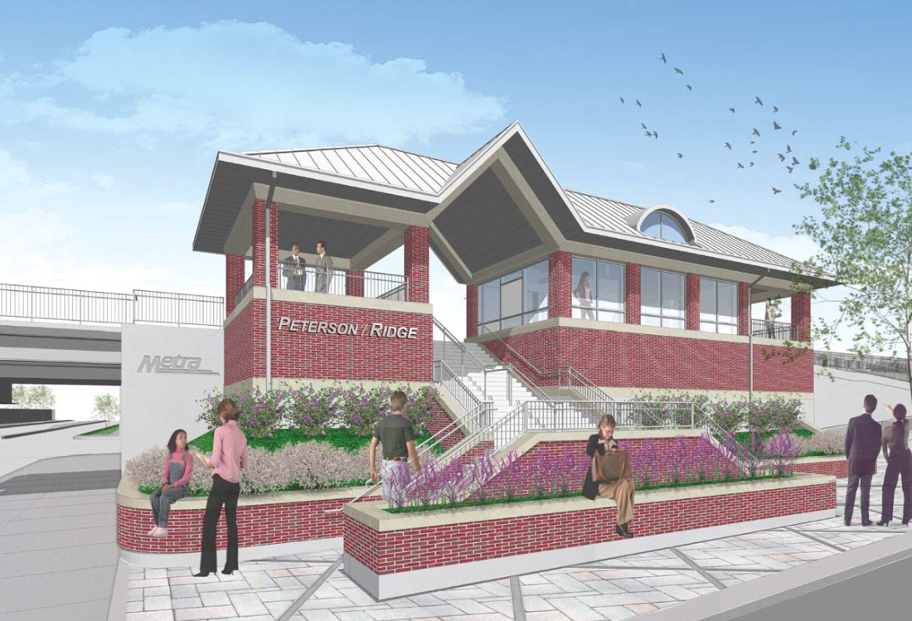
Peterson Ridge Station Warming House Rendering

Slide 8
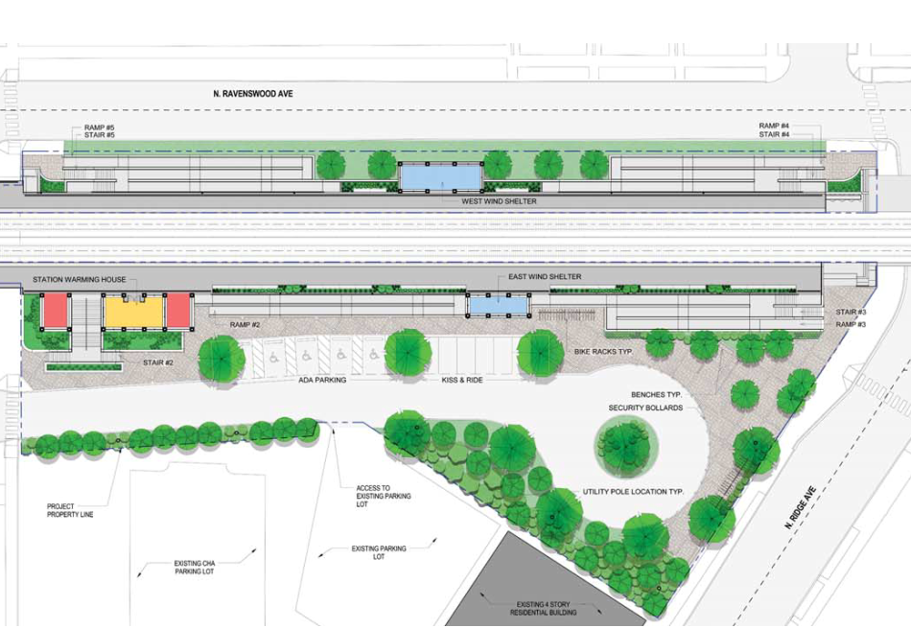
Peterson Ridge Station Landscaping Rendering
RAVENSWOOD AVE.
RAMP
STAIR
RAMP
STAIR
WEST WIND SHELTER
STATION WARMING HOUSE
EAST WIND SHELTER
RAMP
STAIR
BIKE RACK
ADA PARKING
KISS & RIDE
ACCESS TO EXISTING PARKING LOT
EXISTING PARKING LOT
EXISTING PARKING LOT

Slide 9
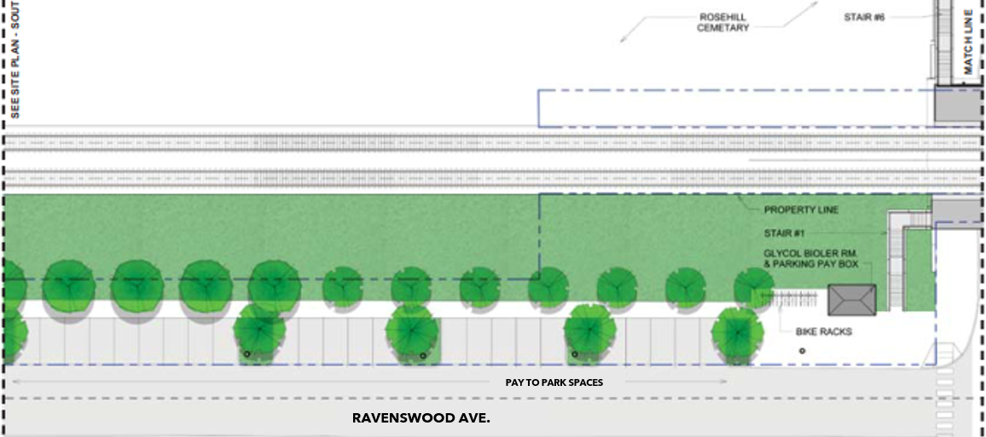
Peterson Ridge Parking
BIKE RACK

Slide 10
Construction Schedule Impacts
The following items contributed to the Peterson Ridge Station construction delays:
1. Platform slope
Platform replacement to comply with ADA standards
2. Roofing material temperature sensitivity
Material is prone to cracking, and can not be installed at temperatures below 50˚ F
3. Station signage
Delayed fabrication due to significant price increase and material availability
4. City of Chicago traffic signal permitting
Additional city scope required coordination with multiple underground utilities
5. Guard rail procurement
Long lead time to procure materials and fabricate

Slide 11
Peterson Ridge Station Progress Photo

Slide 12
Construction Timeline
April 15, 2024 - Contractor substantial completion
April 30, 2024 – Metra begins essential behind the scenes activities
May 20, 2024 - Scheduled station opening
June 30, 2024 - Landscaping completion

Slide 13
Next Steps
Following construction substantial completion, Metra is tasked with several essential steps before the new station can be operational. These tasks include:
Complete landscaping
Coordinate platform (GIS) locations with the positive train control (PTC) system
Verify and test functionality with the Ventra Fare app
Synchronize electronic visual displays with Metra's schedule information
Test train tracking and safety announcement system

Slide 14
Contact us
Andre Vasquez
Alderperson, 40th Ward
City of Chicago
Office: 5620 N Western
Phone: 773.654.1867
Email:
https://40thward.org/contact/
Carrie Peel
John Burns Construction, Senior Project Manager
Office: 999 Oakmont Plaza Drive, Suite 400, Westmont, IL 60559
Phone: 708.670.7381
Email: cpeel@jbcco.com
Noe Gallardo
Metra Legislative & Community Affairs Liaison
Office: 547 W. Jackson Blvd, Chicago, IL, 60661
Phone: 312.735.8781
Email: NGallardo@METRARR.COM

Slide 15
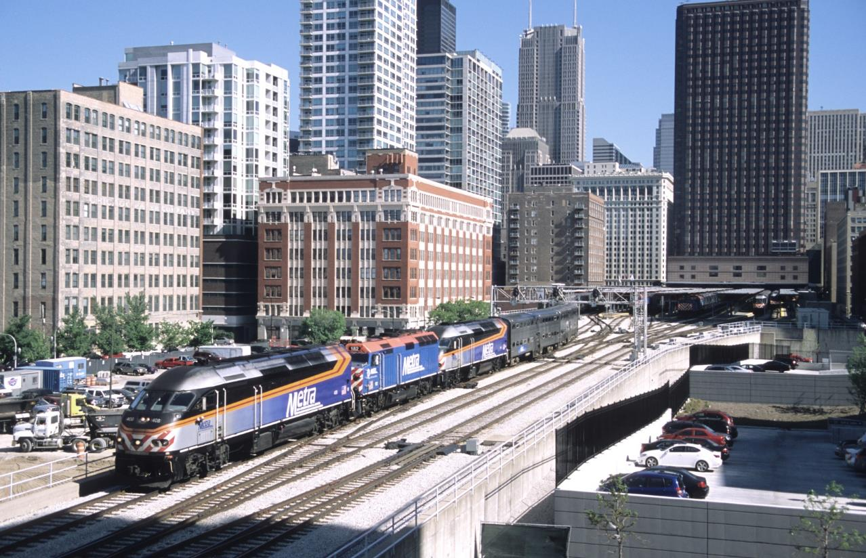
QUESTIONS?

